Slide 1
amazon
sales data analysis

Slide 2

PROBLEM STATEMENT
Sales management has gained importance to meet increasing competition and the need for improved methods of distribution to reduce cost and to increase profits. Sales management today is the most important function in a commercial and business enterprise.
Do ETL : Extract-Transform-Load some Amazon dataset and find for me Sales-trend -> month wise , year wise , yearly-month wise
Find key metrics and factors and show the meaningful relationships between attributes.

Slide 3
Benefits
Help out to make the better business decisions.
Help analyze customer trends and satisfaction, which ca lead to new and better products and services.
Gives better insights of customers base.
Helps in easily flow for managing resources.

Slide 4


Architecture
Data Pre-Processing
Real World
Raw Data Collection
Importing Libraries in Jupyter Notebook
Load Dataset
Missing Value Imputations
Handling Outliers
Data Cleaning
Deployment
Insights
Power BI Desktop
Modelling
Exploratory Data Analysis (EDA)
Reporting
Low-Level Design Document
High-Level Design Document
Architecture Document
Wireframe Document
Detailed Project Report
Low-Level Design Document
High-Level Design Document
Architecture Document
Wireframe Document
Detailed Project Report

Slide 5
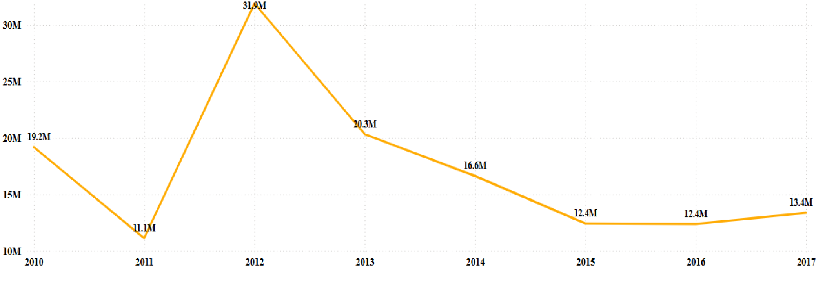
Timeline
As observed from the given dataset from year 2010 to 2017, in the fiscal year of 2012 the Revenue gained is $31.90 Million and the Profit earned is $9.21 Million.
On moving further on the timeline, there is a 36.27% decrease in the Revenue and Profit Margins in 2013 which keeps on decreasing till 2016.

Slide 6
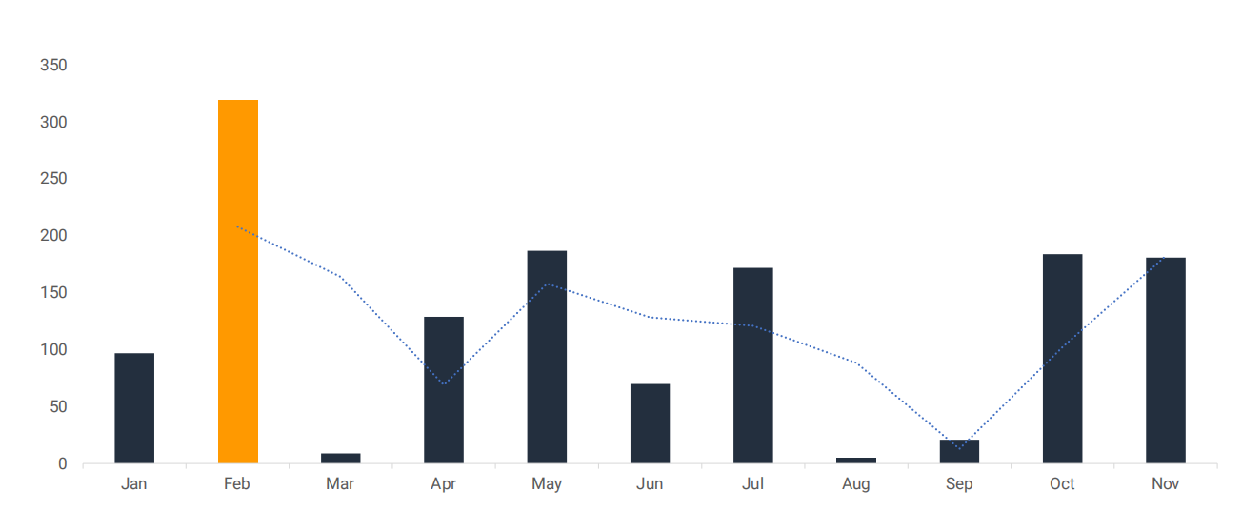
Monthly Growth Chart
The sales in february has the highest sales of 319M

Slide 7
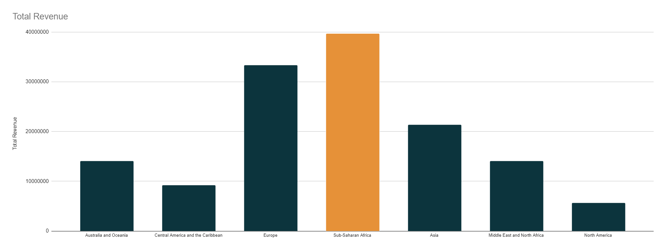
Total Revenue
Sub-Saharan Africa has the highest revenue

Slide 8
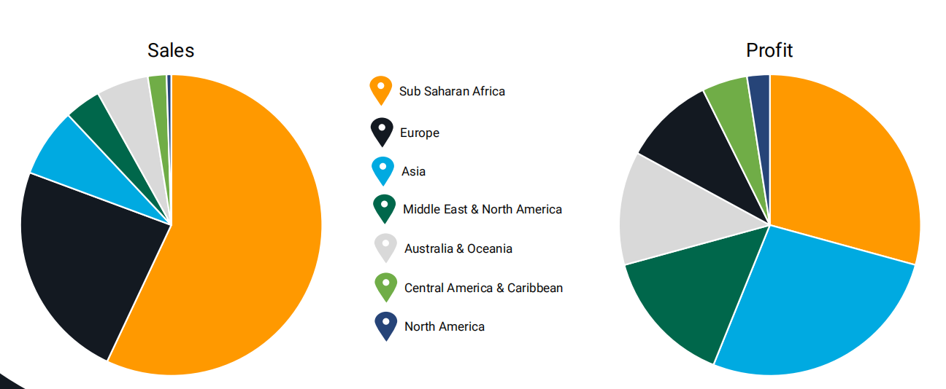
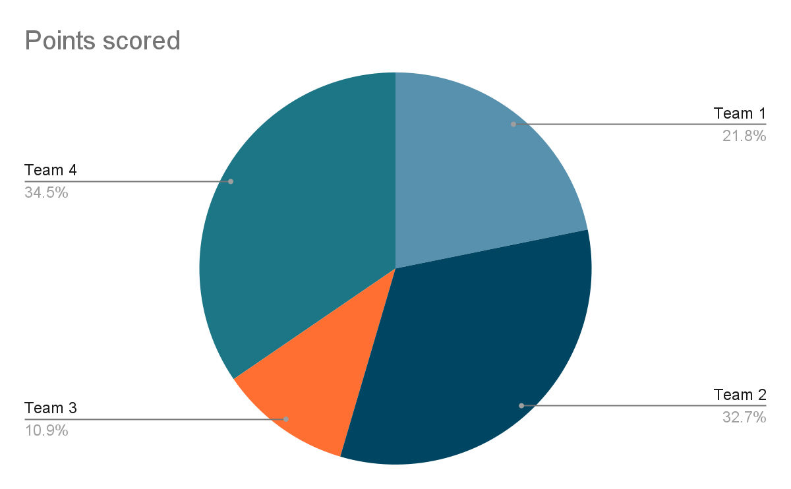
Sales & Profit by the region
Sub Saharan has the highest profit and sales

Slide 9
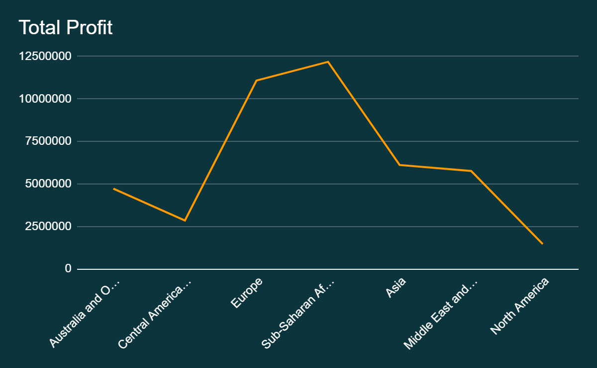
Total Profit

Slide 10
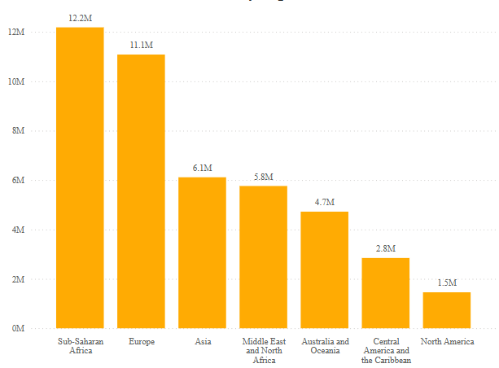
Market Share
Sub-Saharan Africa being the
major contributor with $12.2
Million among the other top
Regions such as Europe with
$11.1
Million, Asia with $6.1 Million
and Middle East and North
Africa with$5.8 Million.

Slide 11
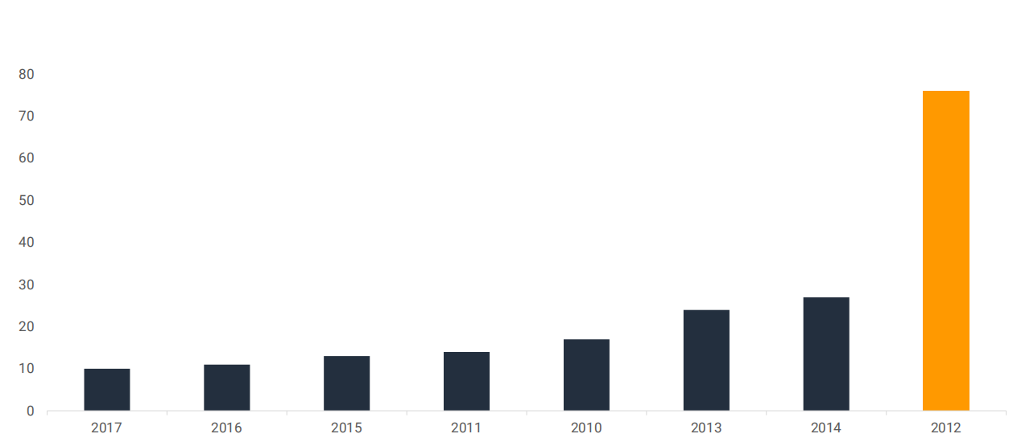
Yearly Growth Chart
2012 has the highest revenue at 76M+ sales

Slide 12
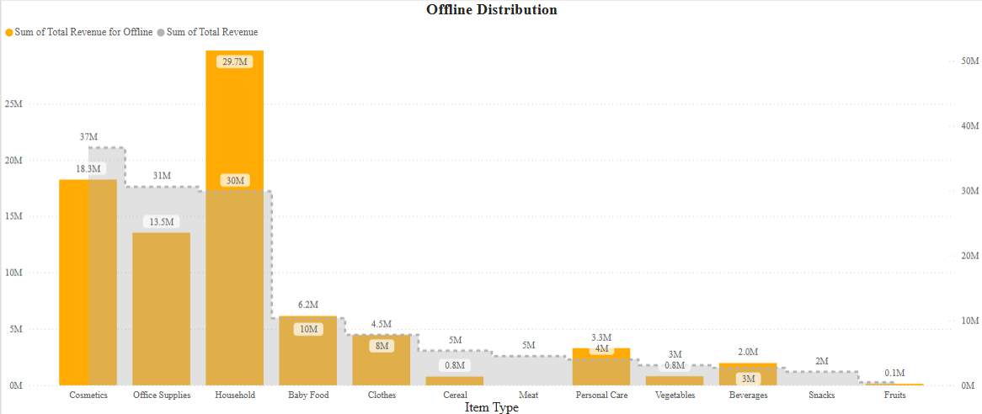
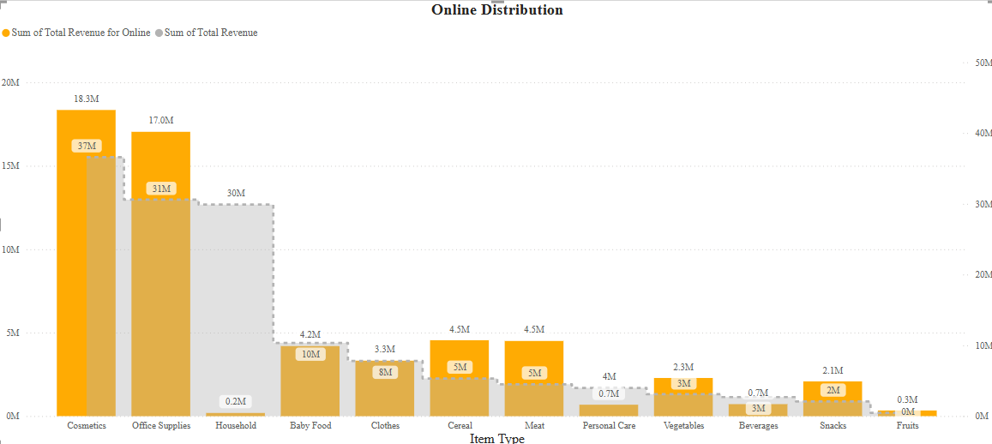
Distribution Chart

Slide 13
thanks!
BRADLY JOHN

